Slide 1
Louisville Electric Scooters:
Morning Setup
Eric Chang, Zhuangzhuang Jia, HaoDi Liu, Madeline Temares, Sijie Wang

Slide 2
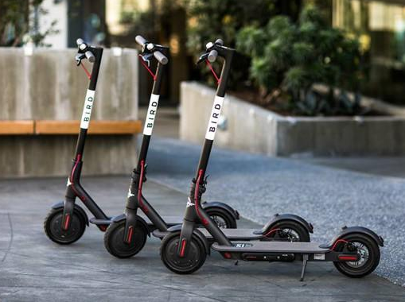
Electric Scooters: A City Solution
Current Operations
Pollution, congestion, gridlock
Bird and Lime scooters (100+ cities)
Chargers/Juicers: pick up, charge, release
Notes:
Dockless e scooters are on the rise in cities across the country and world
They help with the problems of pollution, congestion, and gridlock caused by cars and other vehicles on the road
They are very convenient for customers as you can find one close to you and drop it off wherever works for you
The way the scooters work is that you pay a fixed cost to unlock a scooter and then pay per minute as you ride
Currently, two of the biggest companies in the US are Bird and Lime and these are the companies that our data originate from
Bird valued at $2 billion as of 2018
These companies have a system in which they hire people called Chargers or Juicers who pick the scooters up at night, charge them in their homes, and release them in the morning
This is a current operation that has a lot of room for investigation and improvement
Possibly add slide about their revenue, utilization, cost problem

Slide 3
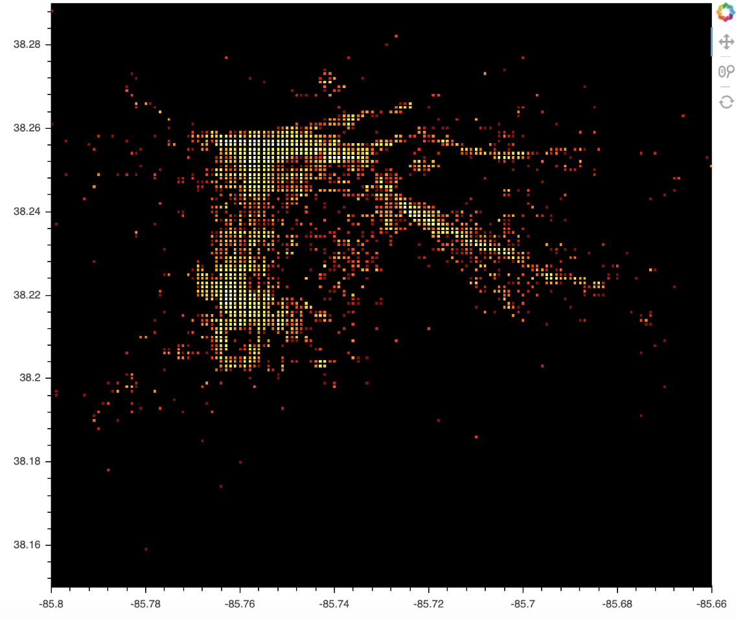
Louisville Scooter Data
Data Preparation
98%
Lime and Bird: anonymous
Trip ID
Start Date, End Date, Start Time, End Time (rounded to nearest 15 minutes)
Trip Duration (minutes)
Trip Distance (miles)
Start Latitude/Longitude, End Latitude/Longitude (rounded to nearest 3 decimal places)
Day of Week, Hour of Day
Removed outliers with respect to latitude and longitude
Notes:
The data that we worked with is from the city of Louisville
It has the ride data from both Lime and Bird - the data is combined and anonymized
This unfortunately removes the ability for us to compare the companies but we chose to analyze it as if it was one company providing the scooters
The attributes we had were trip ID which was just assigned to each trip, the starting and ending date and time -- the time is rounded to the nearest 15 minutes
We had the trip duration and distance and the day of the week and hour
The attributes that proved the most valuable to us were the start and ending points which were given in latitude and longitude
There were a few rides that had errant GPS data so we removed those from our analysis
One attribute that we did not have access to is scooter ids - they decided to remove this for the privacy of customers so we had to work around this challenge without being able to actually track the movement of scooters - this also meant we didn’t know the total number of scooters in the city’s system or how many scooters were in a given place at a given time
You can see here a visual of where the scooter trips are originating, and where they are ending gives a very similar look
These densely populated areas of traffic follow basically exactly with the densely populated areas of Louisville

Slide 4
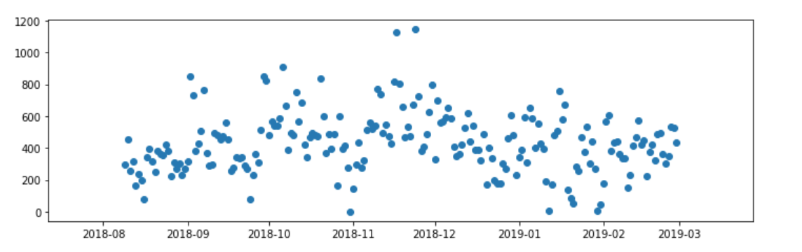
Problem
Proposed Solution
Balancing of scooters
Scooters may accumulate in areas with low demand
May be losing demand due to unavailability of scooters where wanted
Provide simulation for daily movement of scooters with captured and lost demand measures based on morning setup
Provide reasonable option for morning setup of scooters
Notes:
So with this dockless system, the problem we saw was with the balancing of scooters
Scooters can accumulate in areas with low demand and sit idle and not be used
As scooters are in areas with low demand, they are being taken away from areas with high demand which may be running out of scooters and then demand is lost in these areas
We can see here that over time, the number of rides per day has not really increased - the system therefore has room for improvement and think that understanding utilization of the scooters and increasing that utilization is key for growth
Because we know that these companies have systems in place in which people pick up the scooters and charge them overnight before they release them, our solution works on the morning setup
If the company knows the setup of the morning, we have provided a simulation that will show the movement of the scooters throughout the day as well as the demand captured and lost
With this simulation, we are able to provide a reasonable option for a morning setup of scooters that will capture a lot of the demand and lose a minimal amount
However, we think that the greatest value this has is that different setups can be tested - if they know how the night is ending, they can see if the scooters go out in the same way what this will mean for the next day’s movement and demand

Slide 5
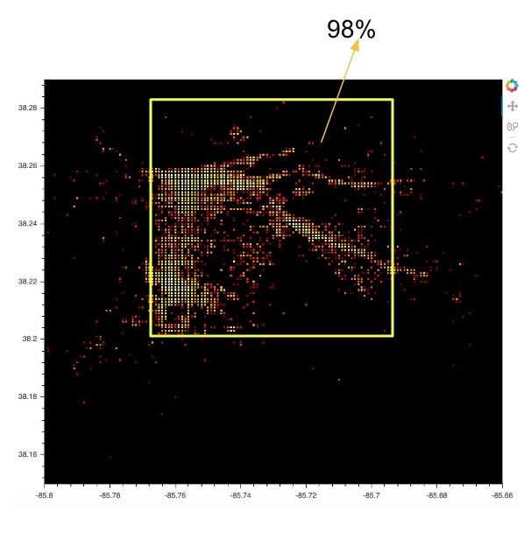
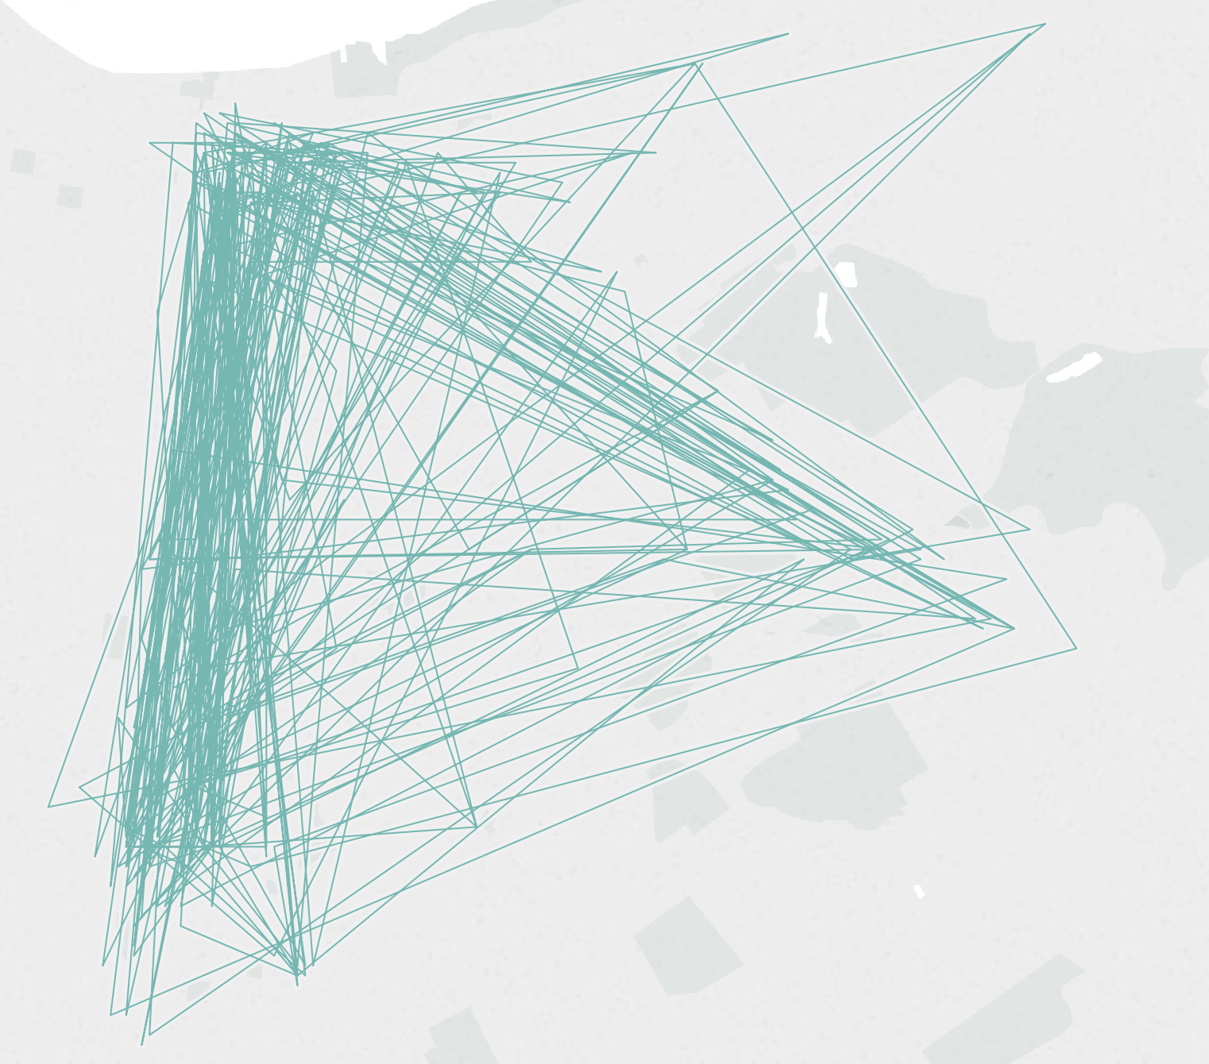
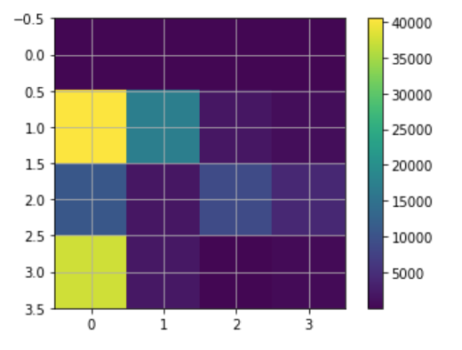
Zones
1.29miles
Divided city into 16 zones
Examined flow in and out of zones
1.5miles
Notes:
To accomplish this simulation, the first thing we did was divide the city into 16 zones
We did so with straight latitude and longitude lines
This was a really important thing for us to do because it allowed us to measure where a lot of rides are flowing in and out of and have a sense of areas - especially important because it is a dockless system
You can see here each square is a zone and we saw that zones 1 2 and 3 clearly had the most starting flows

Slide 6
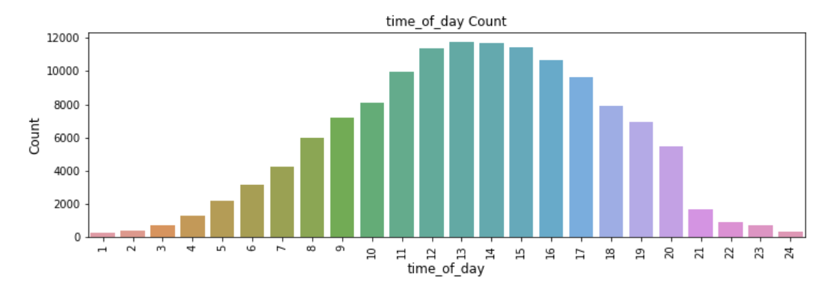
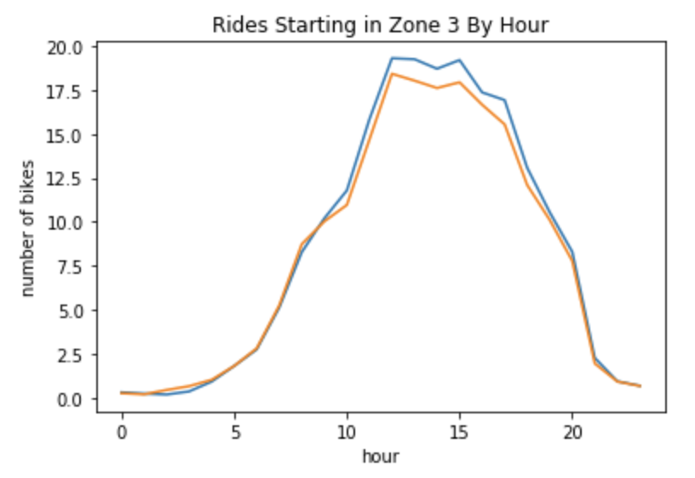
Daily Flow
Hourly transition matrices
Notes:
Then we looked at each zone and examined more closely what happens by hour. We saw a similar pattern in each zone that showed that there were more rides in the middle of the day which would be when the sun is out and makes sense
So as we were looking at the data, because the demand varied greatly by hour, which we can see also here, we could not treat the entire system as stationary
We made the decision to look at each hour in each zone and come up with transition matrix describe the transition process each hour

Slide 7
Simulation Assumptions
Assumed one company
Assumed 250 scooters in city
For each hour, assumed flow out [and arrivals] follow Poisson process with lambda equal to the average flow out of [and into] that zone
Assumed number of scooters + (½) arrival of scooters is available each hour
Used low average lost demand percentages for each hour
Notes:
So in our simulation we made a few assumptions
Like i mentioned, we assumed that this data came from one company because they were merged
We assumed there are 250 scooters in the system for the numbers we tested but as this number fluctuates and grows and shrinks in the real scenario, the simulation can handle any number of scooters starting in any zone
We also assumed for each hour, that the flow out and in of a zone follows a Poisson process with the parameter being equal to the measured average flow out of or into that zone
We also conducted our simulation such that we assumed each hour that the scooters available for a ride were those that are in the zone plus the number of scooters flowing into that scooters since they could be used later in the hour
One thing that we wanted to factor into our simulation was that the data only captures completed trips so it loses a factor of lost demand
The way that we aimed to account for this is that our simulation takes in a parameter of average lost demand per hour - we entered a reasonable and low lost demand parameter but this is also something that we believe the companies might have a better idea of

Slide 8
Simulation
Simulated movement of scooters throughout day based on transition matrices
Counted demand captured and lost
Enough scooters → all demand captured
Not enough scooters → does flow in help?
Compared
Naive setup: equal scooters in each zone
Demand percentage setup: number of scooters in each zone proportional to flow out
Morning demand percentage setup: number of scooters in each zone proportional to flow out for morning hours 6-10AM
Notes:
So the way our simulation worked was that we wanted to simulate the movement of scooters throughout the day based on the transition matrices that we had computed
In order to do so, we simulated demand each hour as a Poisson random variable with the average being the mean of the flow out of that zone in that hour
And like i said before, we wanted to account for real world lost demand so we added on a factor to account for this
Throughout the simulation, we counted the demand captured and lost based on the way the scooters were moving and the simulated demand
If there were enough scooters in the zone, the demand was captured but if not, we looked to the flow into the zone to see if that could help capture the rest
We compared three morning setups
The first being a naive setup which would be to not factor in the history of rides and demand and just put an equal number of scooters in each zone
We compared this with a setup which put the number of scooters proportional to the flow out of these zones over the course of the data we have
We also compared this with a setup which was proportional to the flow out only for the morning hours of 6-10AM
The two proportional setups were very similar

Slide 9
Simulation Pseudocode
def function (morning setup, lost demands):
for each hour:
for each zone:
simulate demand = (~Poisson(lambda) + lost demand factor)
if #scooters in zone >= simulated demand:
increment demand captured
else:
check flow in of scooters
increment demand captured as necessary
increment demand lost as necessary
if scooters in zone:
scooters moving = min(simulated demand, scooters in zone)
for each scooters moving:
simulate random number
move according to transition matrix probability
Notes:
A brief pseudocode of the simulation can be seen here
We can take in any morning setup and real world lost demand parameters
We go through each hour and each zone and simulate the demand
If there are enough scooters, we increment the demand captured
If there are not, we check if the flow in of scooters helps and adjust the demand captured and lost accordingly
If there are bikes in the zone we then account for how many would be moving which would be the less of the simulated demand and the bikes in the zone
For each of these, we simulate a random number and move the bike according to the transition probabilities we obtained from the transition matrices

Slide 10
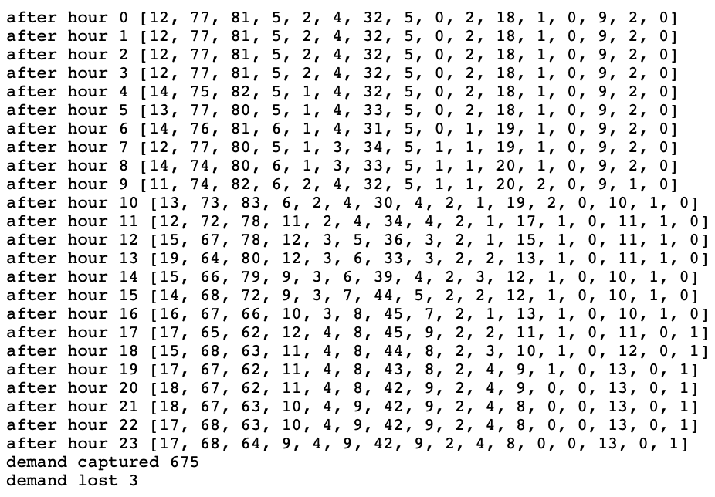
Reasonable Morning Allocation of Scooters
Result
Naive setup: 16 bikes in each zone
Average demand captured = 651
Average demand lost = 16
Proportional to Demand setup:
Average demand captured = 655
Average demand lost = 4
Proportional to Morning Demand (6-10AM) setup:
Average demand captured = 668
Average demand lost = 8
Notes:
Our simulation outputs something like this where we can see the movement of the scooters after each hour and what the total demand captured and lost was for the day
We found that all simulations capture a similar amount of demand but the difference lies more in the amount of demand lost
We recommend a setup that follows more closely to setting up the scooters in a way that is proportional to the flow out of zones but we believe that our simulation is valuable in its ability to test many different setups and see what can happen over the course of the day

